Slide 1
The power of the md5sum
Check your files!

Slide 2
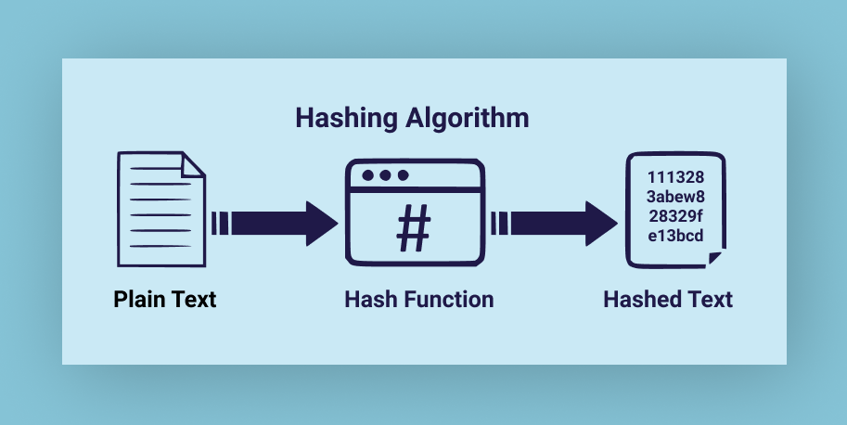
md5 is a hashing function
What is a Hash Function?
A hash function is a mathematical function or algorithm that simply takes a variable number of characters (called a ”message”) and converts it into a string with a fixed number of characters (called a hash value or simply, a hash)

Slide 3
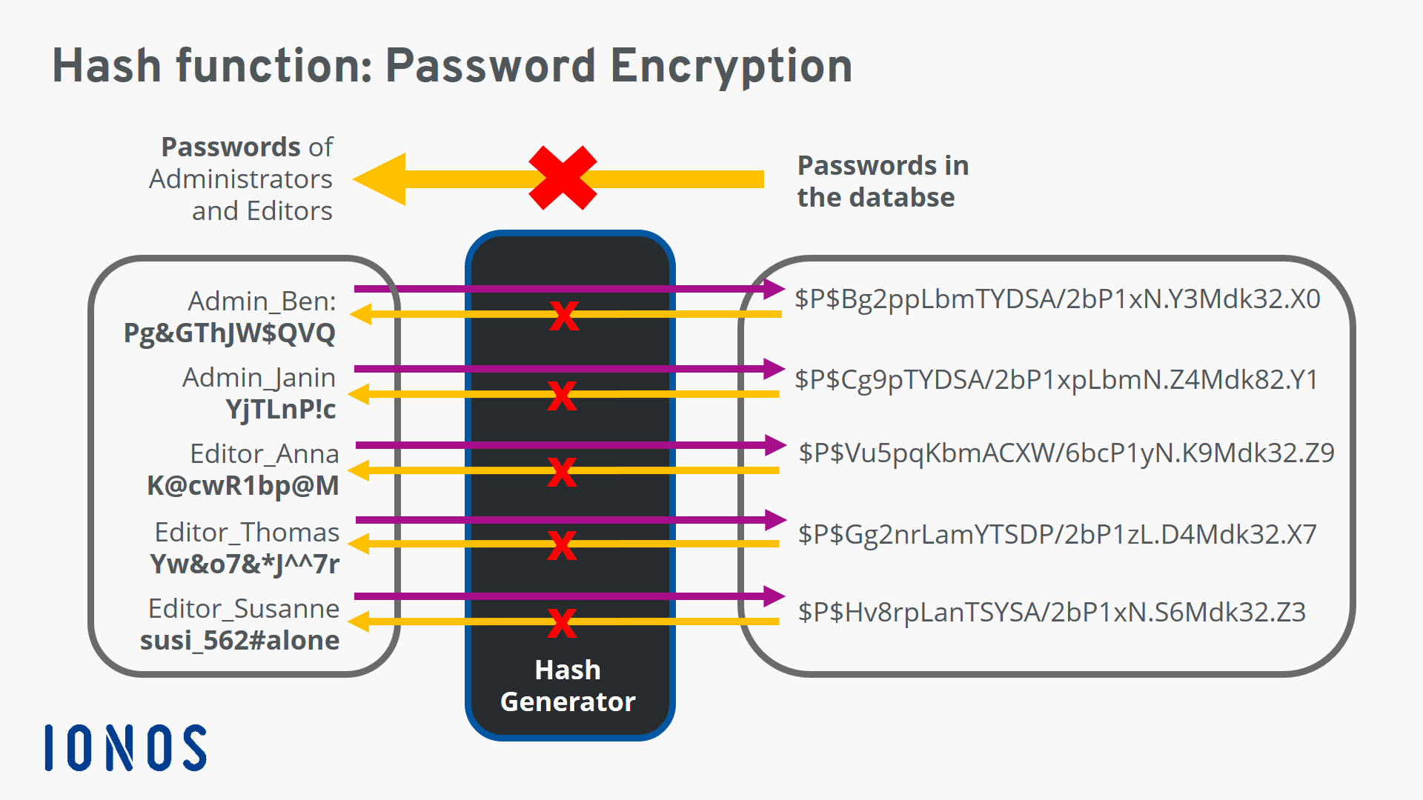
What is a Hash Function?
A hash function is a mathematical function or algorithm that simply takes a variable number of characters (called a ”message”) and converts it into a string with a fixed number of characters (called a hash value or simply, a hash)

Slide 4
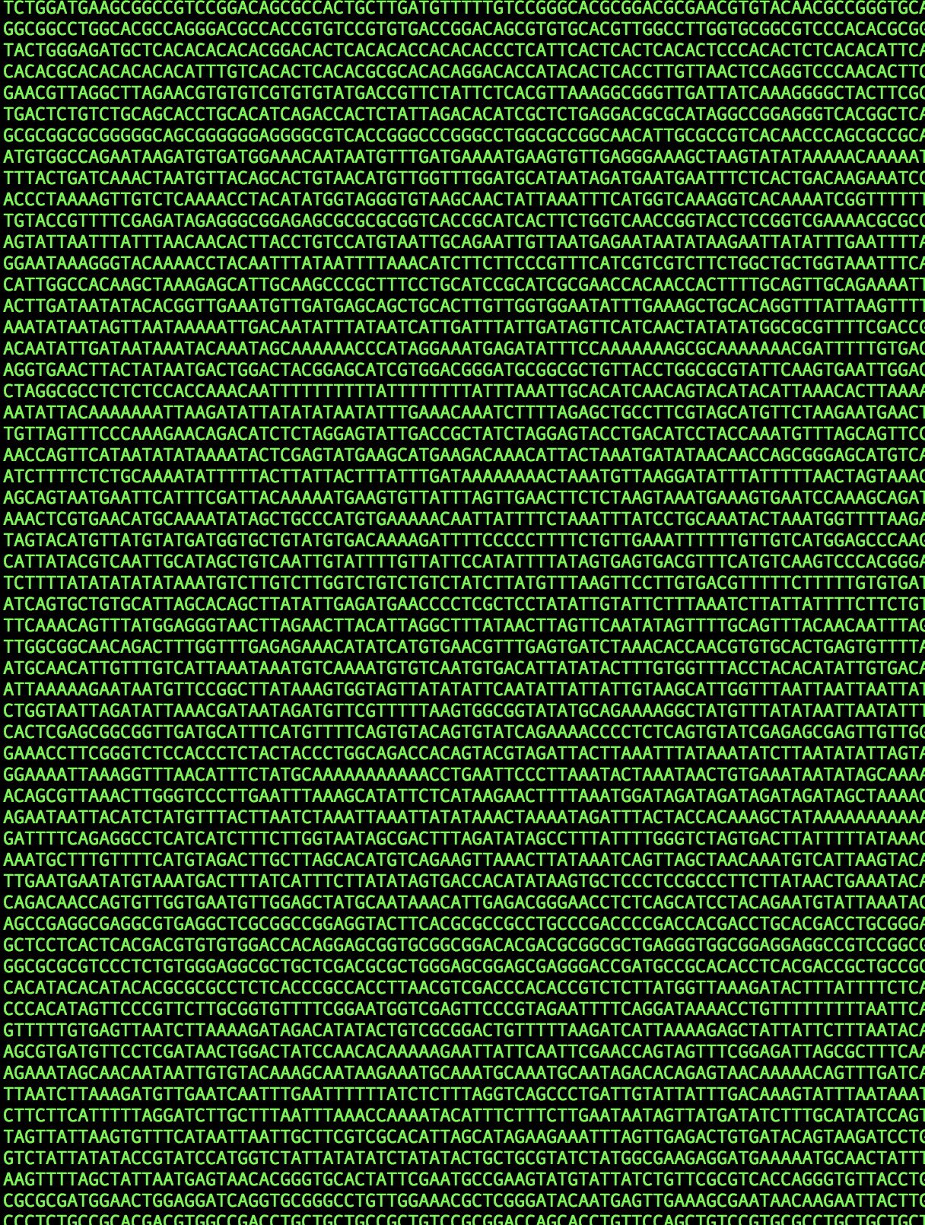
An introduction to genome assembly

Slide 5
Part 1: The logic of genome assembly

Slide 6
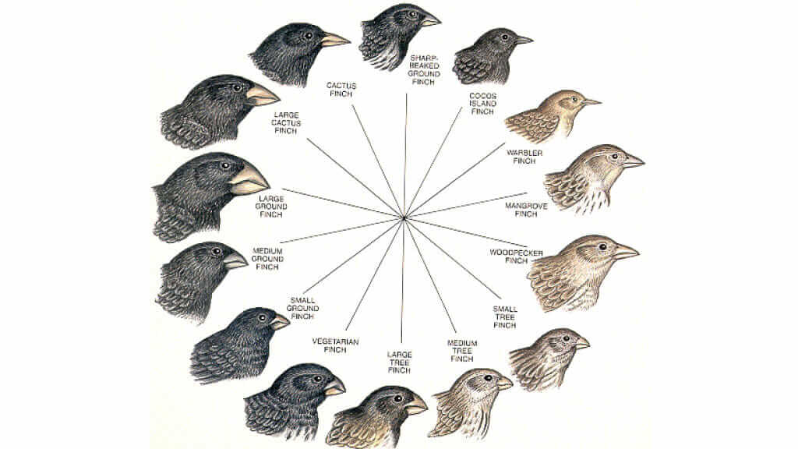
To find similarities and differences between individuals/populations/species we need something to compare against

Slide 7


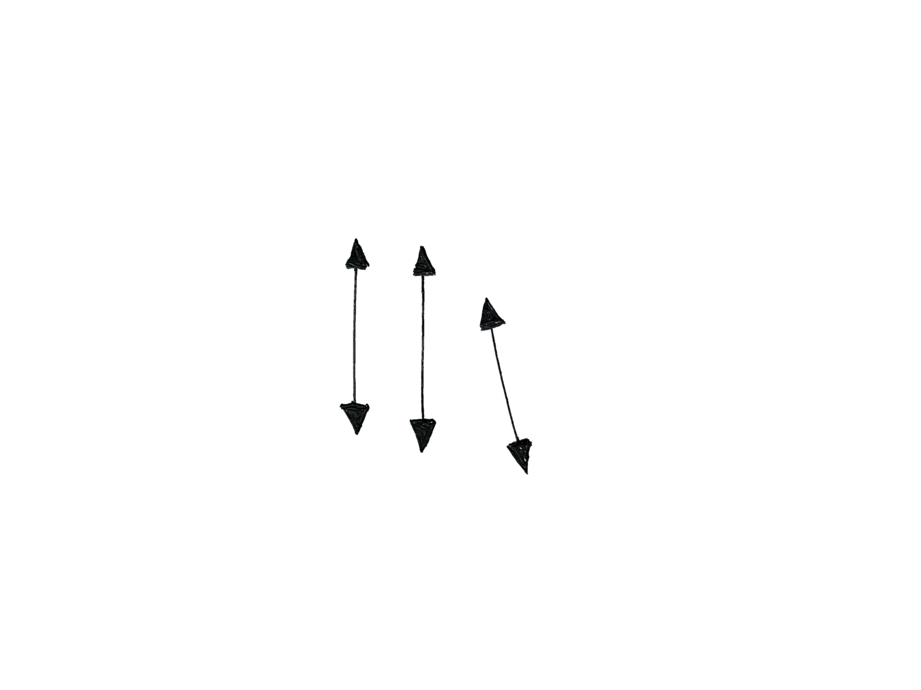



Slide 8
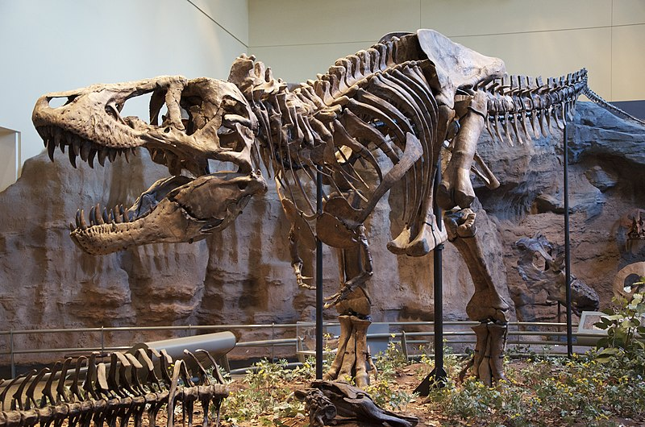
In taxonomy we are used to having one representative individual – the holotype

Slide 9
In taxonomy we are used to having one representative individual – the holotype
We want the genetic equivalent of a holotype!

Slide 10



10k species →
1 million+ species

Slide 11
Part 2: The challenges of genome assembly

Slide 12
The problem: Even our longest sequencing approaches can only sequence fragments ~ 10kb to good quality Qn: So how do we get a representative sequence representation of a reference individual?

Slide 13
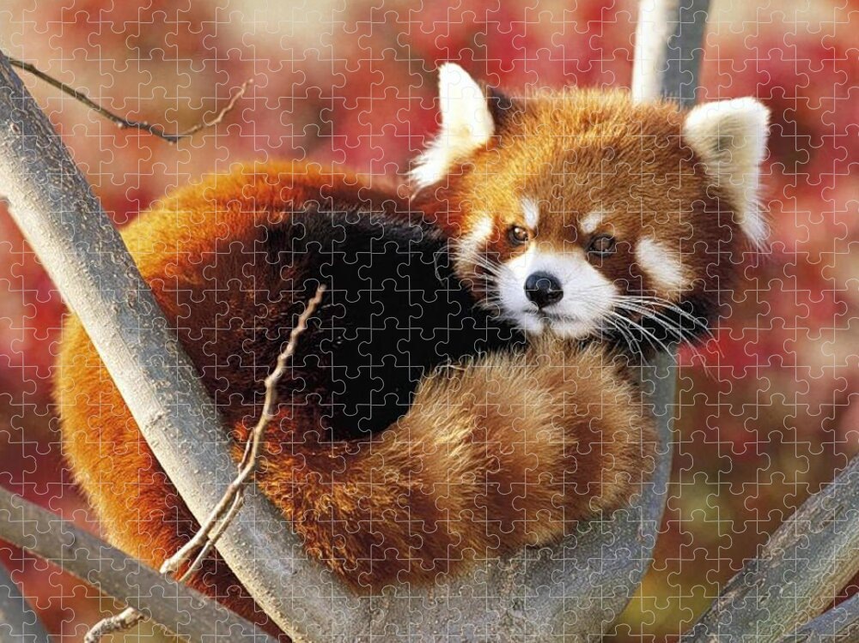
Piece together a reference from the fragments we get from sequencing a genome

Slide 14


We sequence multiple copies of the genome to ensure we sequence everything

Slide 15
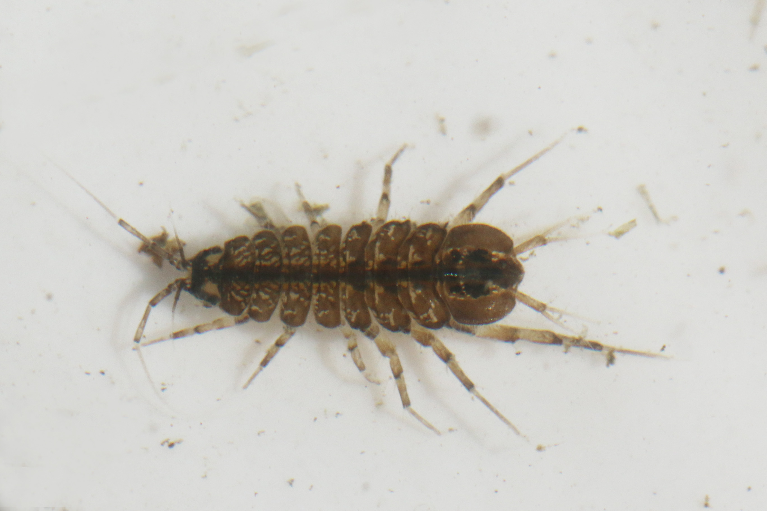
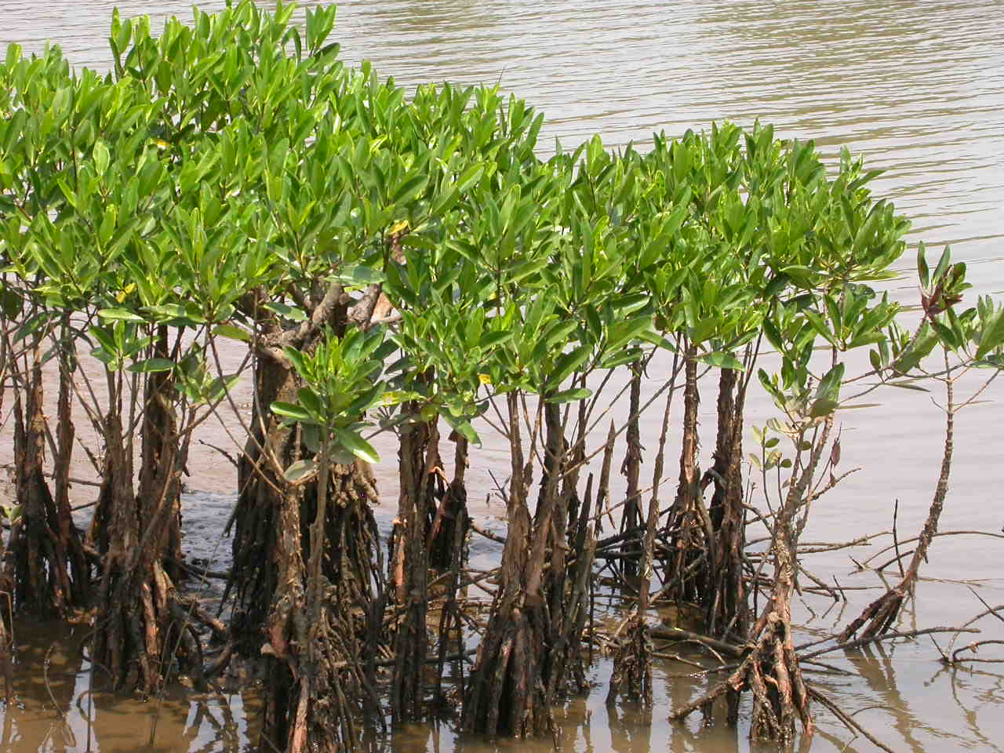
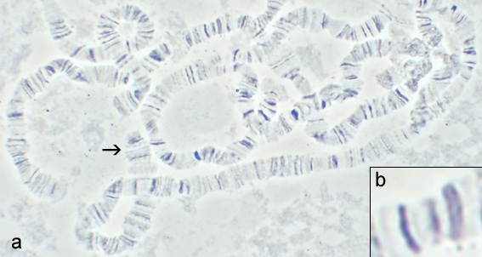
What makes sequencing hard? The organism
Not all tissues are equal when it comes to extracting DNA – mechanical difficulties
Not all organisms give up their DNA – metabolites and other inhibitors
There isn’t always a lot of tissue

Slide 16
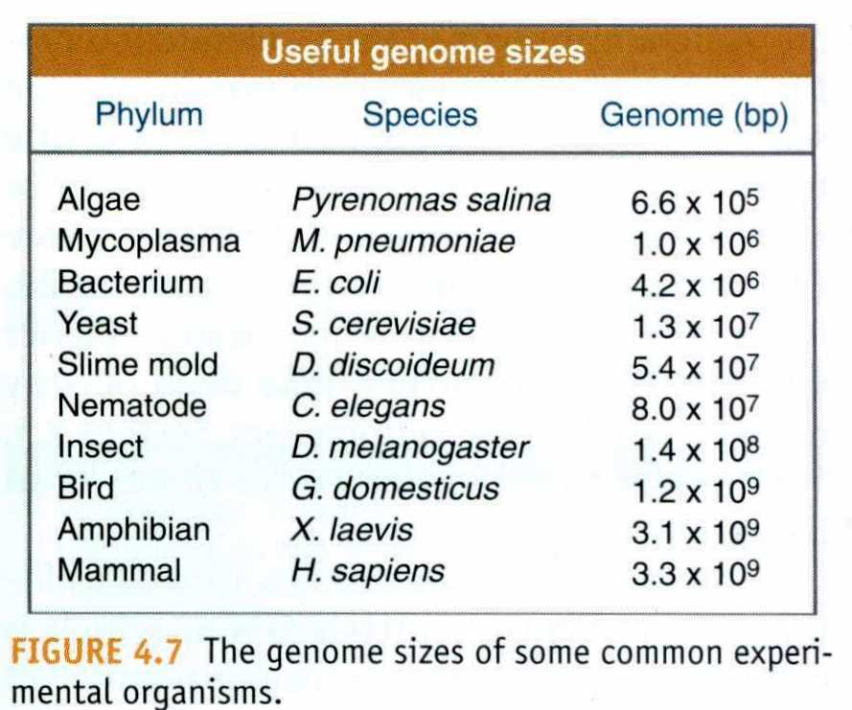




What makes sequencing hard? The tech
Gambusia = ~675 Mb
Poecilia = ~720 Mb
Brown bear = ~2.47 Gb
Blue whale = ∼2.7 Gb

Slide 17
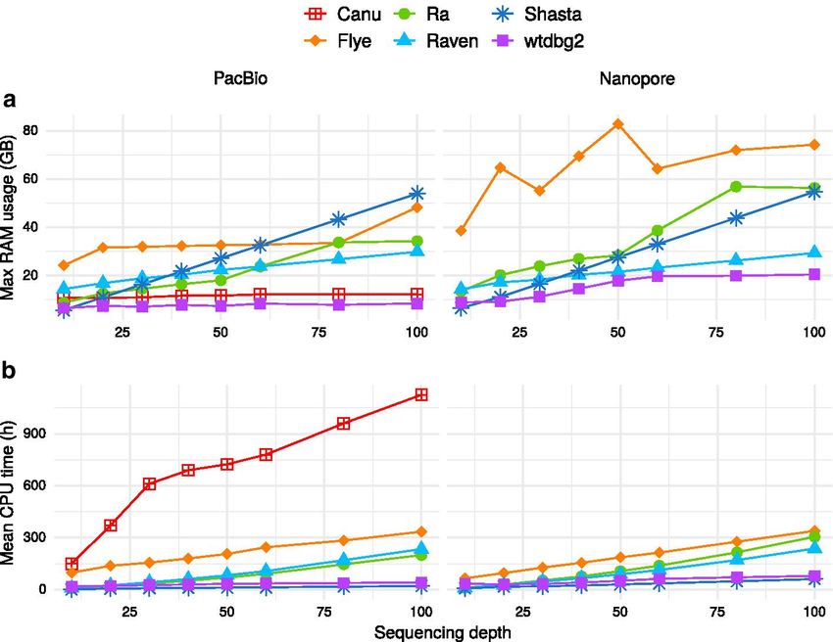
What makes sequencing hard? The tech

Slide 18
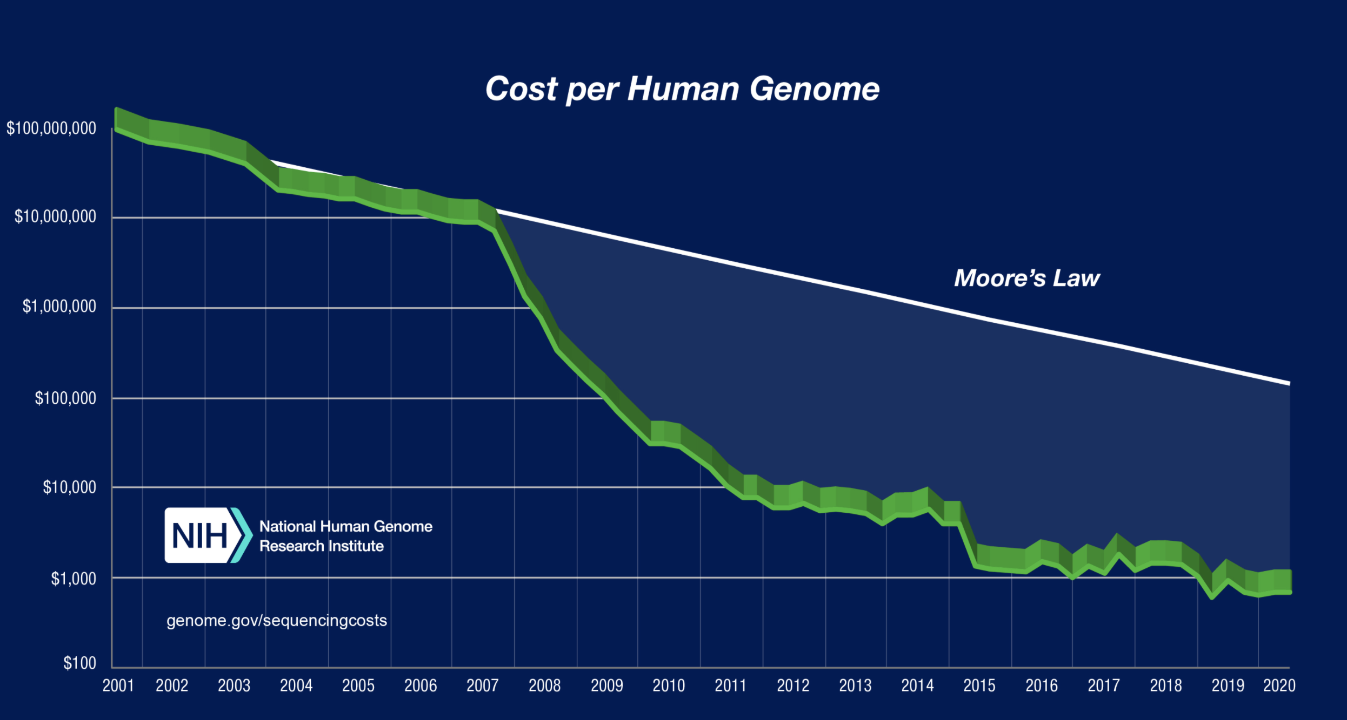
What makes sequencing hard? The cost

Slide 19
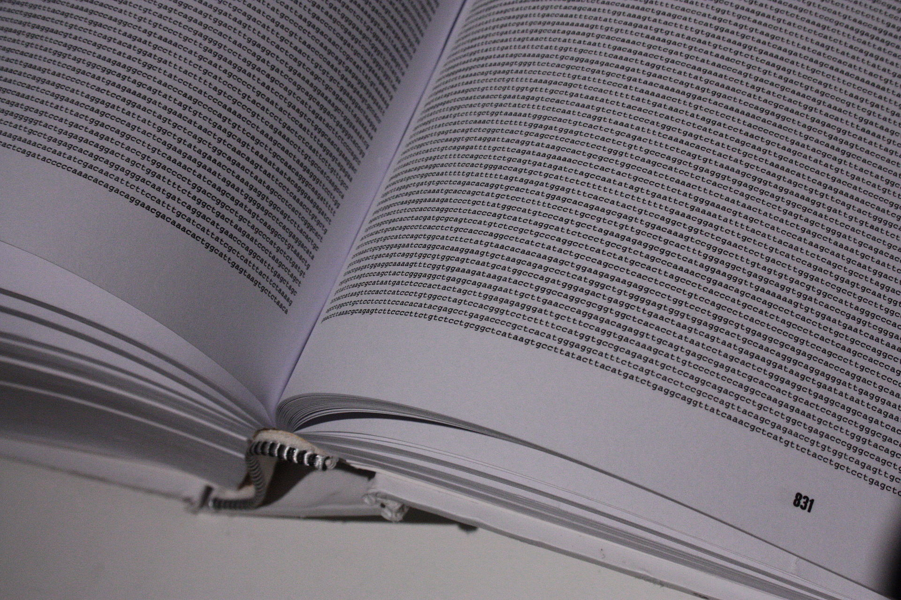
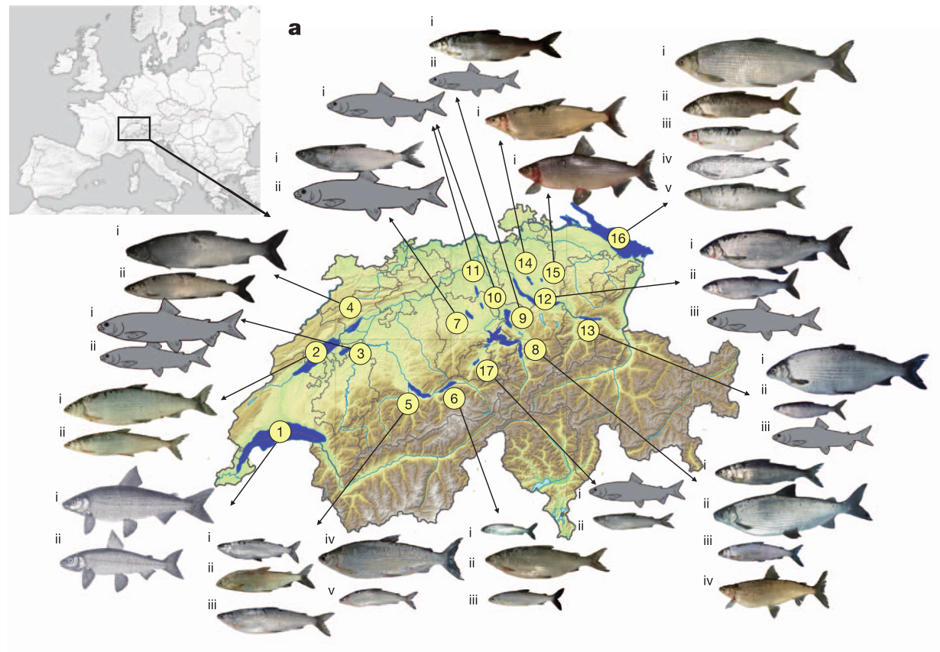
There have been a lot of advancements
The Human Genome Project took from 1990 to 2003 and cost around $1bn
During my PhD I assembled a 2.3 Gb whitefish genome and analysed a 100 whitefish whole-genomes
The genome took 21 CPU years to run!

Slide 20
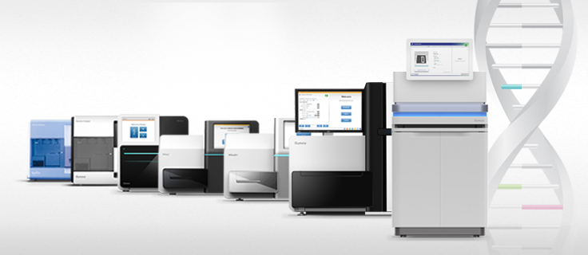
Increase in sequencing output for Illumina
1 Gb output
6 Tb output
20 billion reads

Slide 21
The many names for sequencing approaches
High Throughput sequencing = Next Generation sequencing
2nd generation sequencing
Short read sequencing
Illumina
3rd generation sequencing
Long-read sequencing
PacBio
Nanopore
High Throughput sequencing
Next Generation sequencing
2nd generation sequencing
Short read sequencing
3rd generation sequencing
Long-read sequencing
Illumina
PacBio
Nanopore

Slide 22
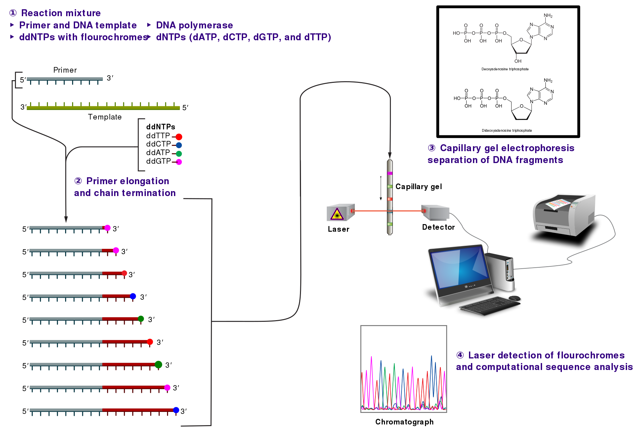
The old school – Sanger sequencing

Slide 23
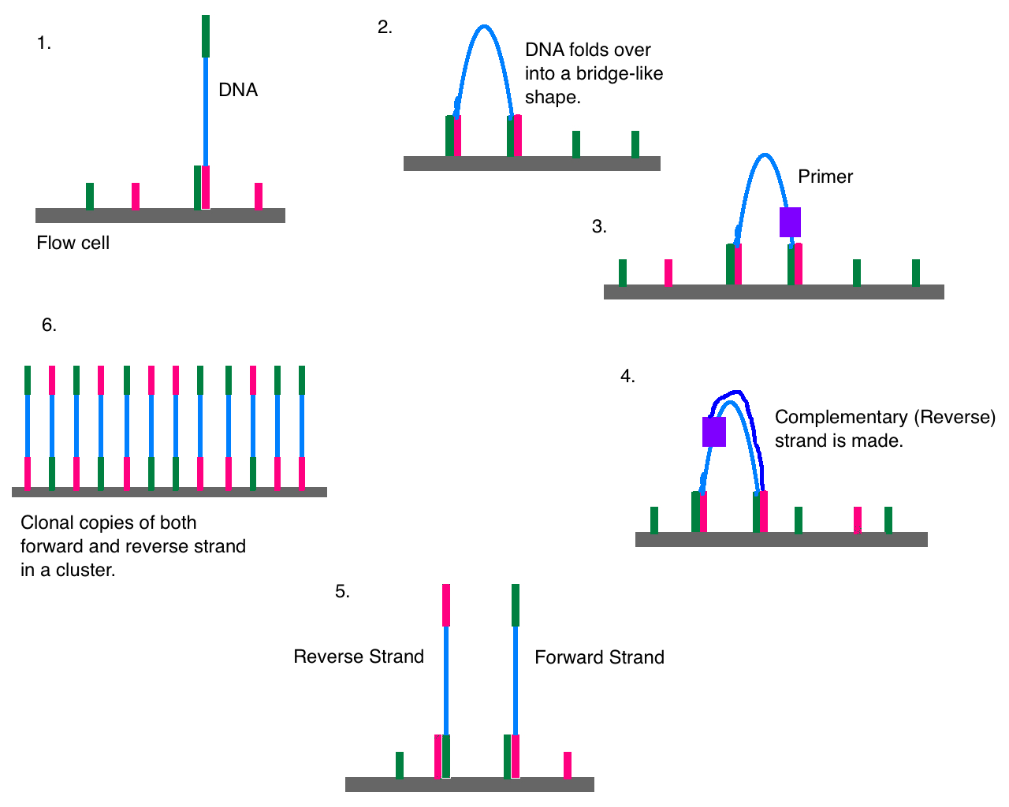
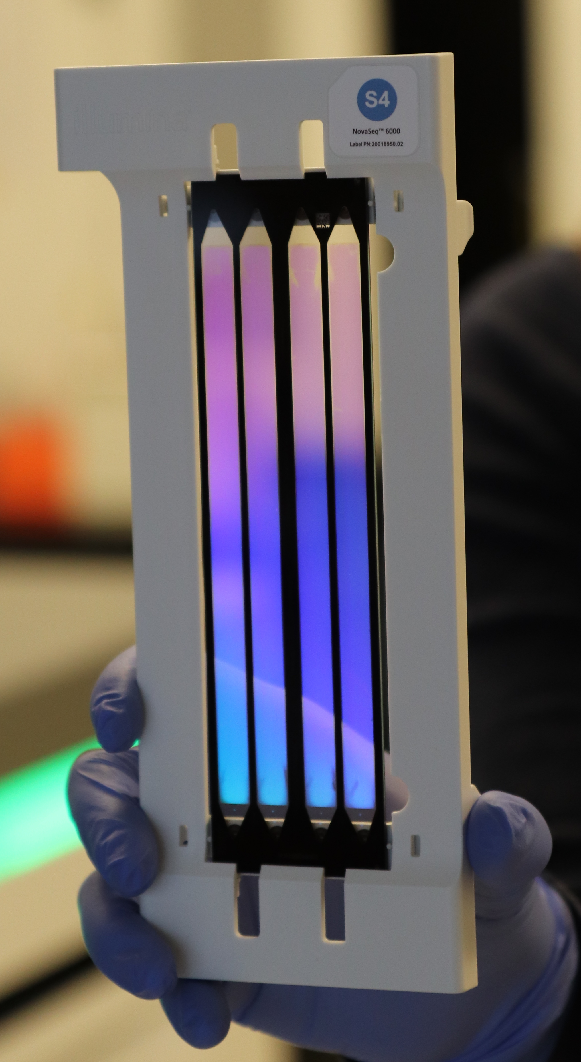
Illumina – how does it work?
https://brcf.medicine.umich.edu/wp-content/uploads/2018/10/IMG_0466.jpg
https://upload.wikimedia.org/wikipedia/commons/6/65/Cluster_Generation.png

Slide 24
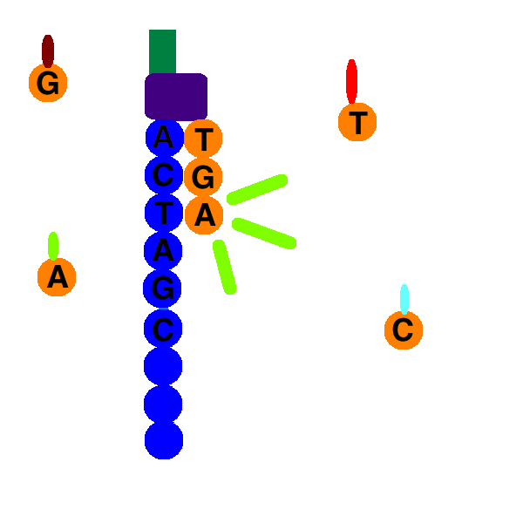
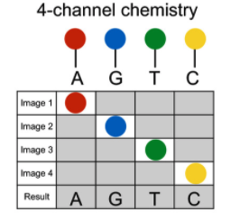
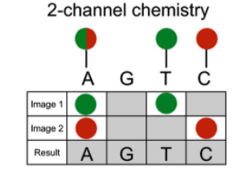
Illumina – Sequencing by synthesis

Slide 25
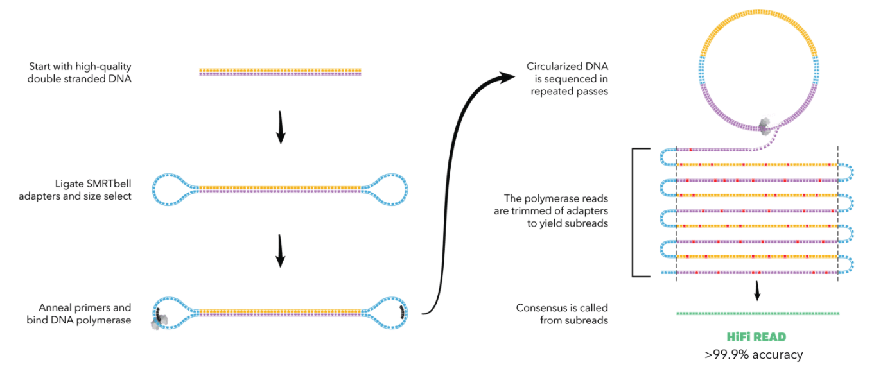
PacBio – how does it work?

Slide 26
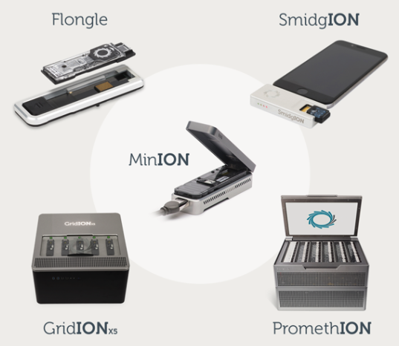
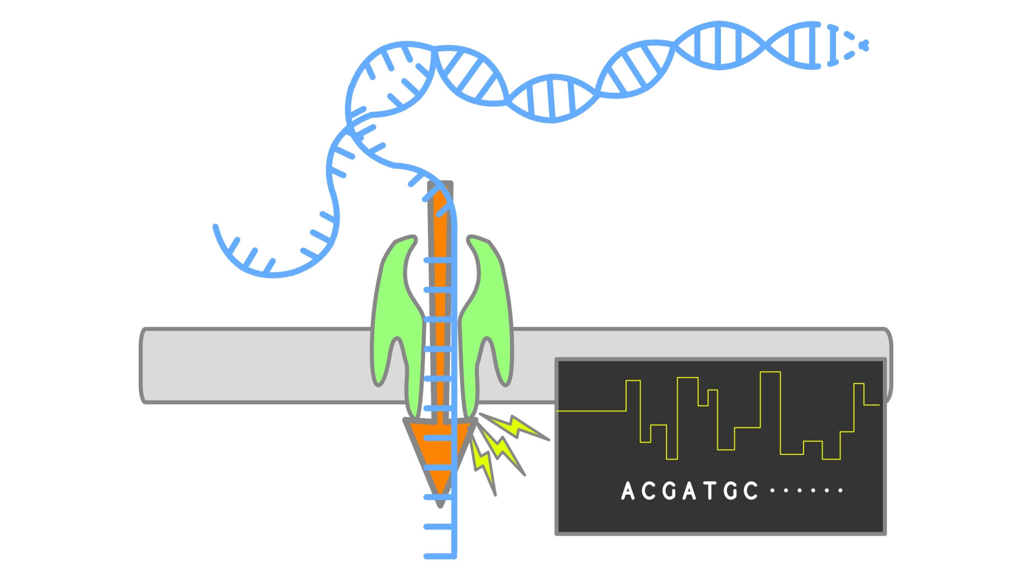
ONT – how does it work?
https://nanoporetech.com/about-us/news/oxford-nanopore-announces-ps100-million-140m-fundraising-global-investors
https://en.wikipedia.org/wiki/Nanopore_sequencing#/media/File:202001_nanopore_sequencing.svg

Slide 27
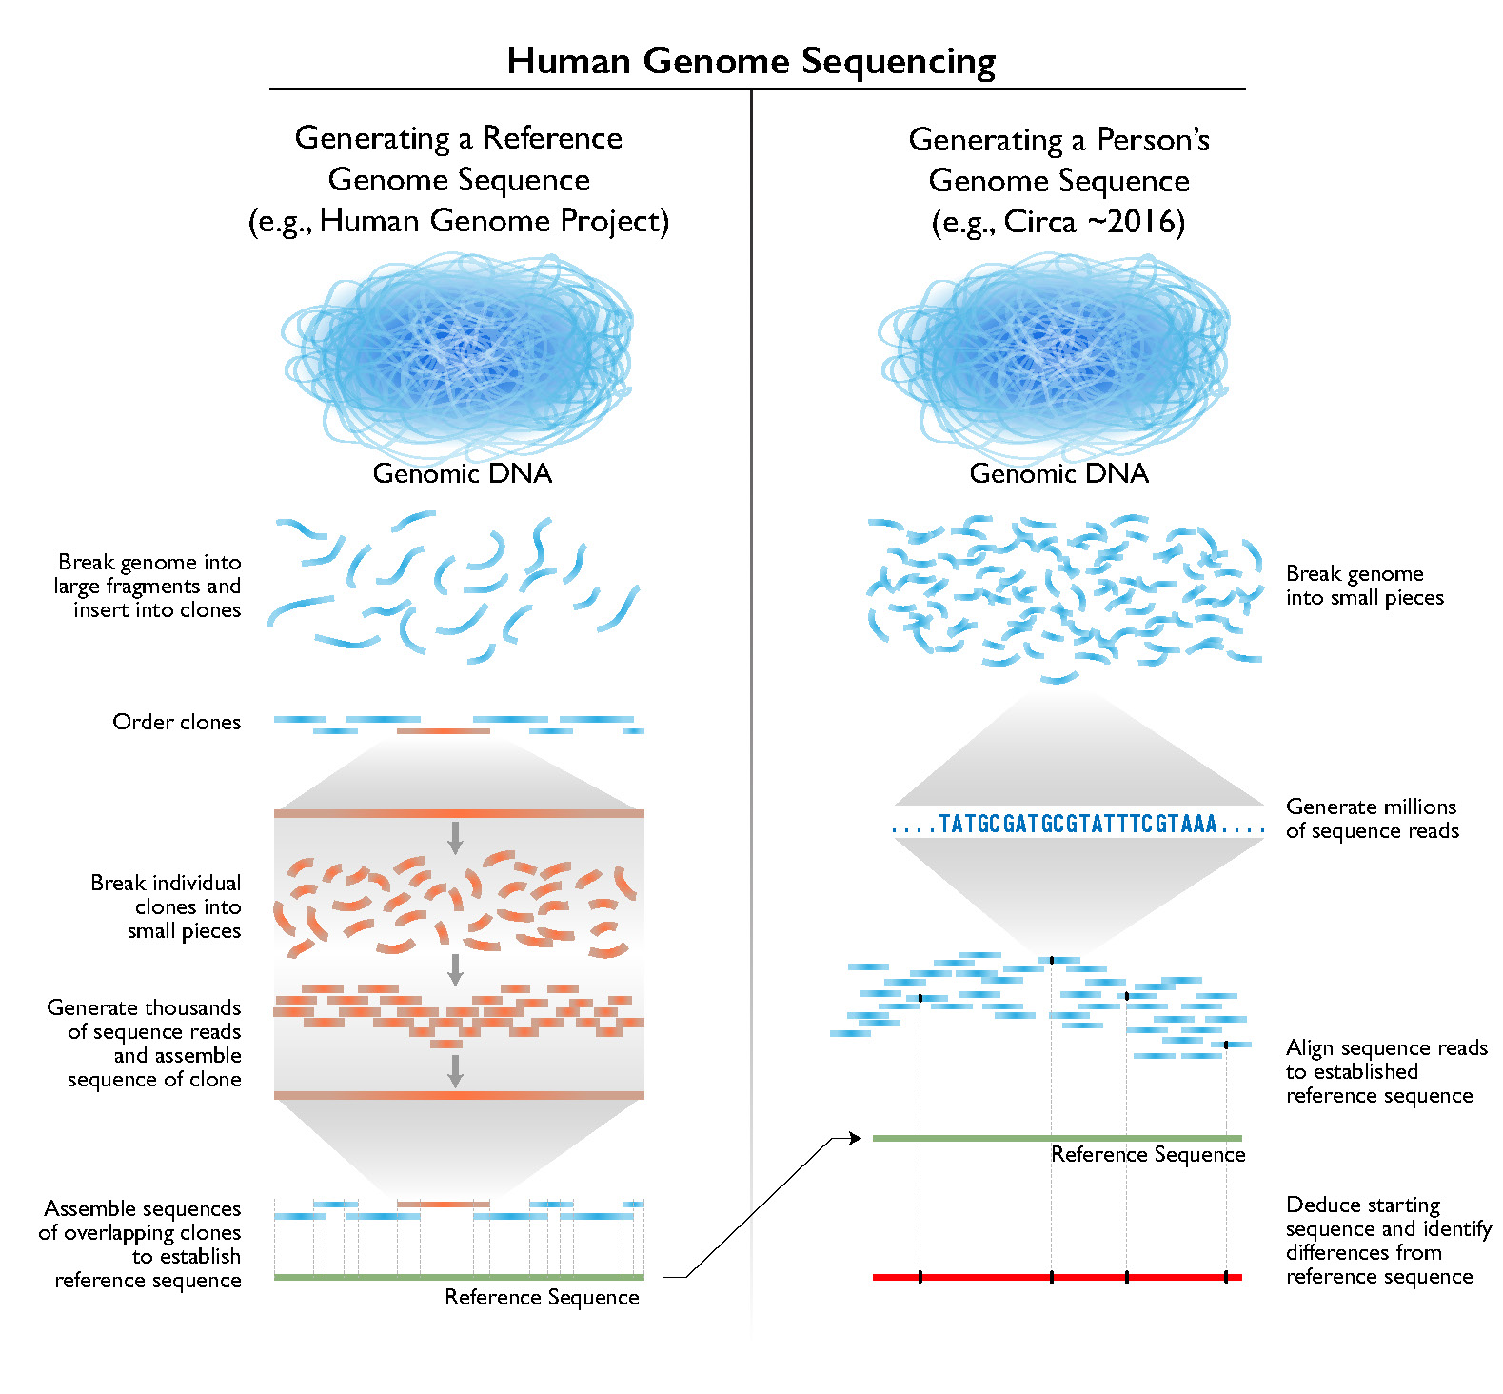
Whole-genome shotgun sequencing
DNA is cut up into manageable bits
Adapters are added
Reads can be selected based on size
These are then sequenced from both ends

Slide 28
The assembly process
Assembly
Scaffolding
Raw reads
Contigs
Scaffolds
No info added
New info added

Slide 29
The assembly process
Assembly
Scaffolding
Raw reads
Contigs
Scaffolds
No info added
New info added

Slide 30
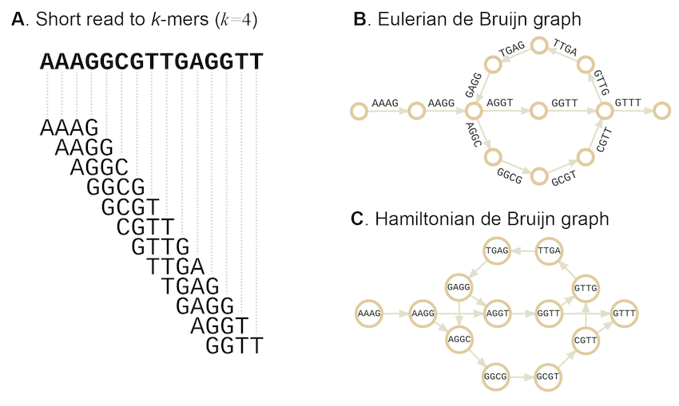
The de bruijn graph – the foundational idea behind the genome assembly puzzle

Slide 31
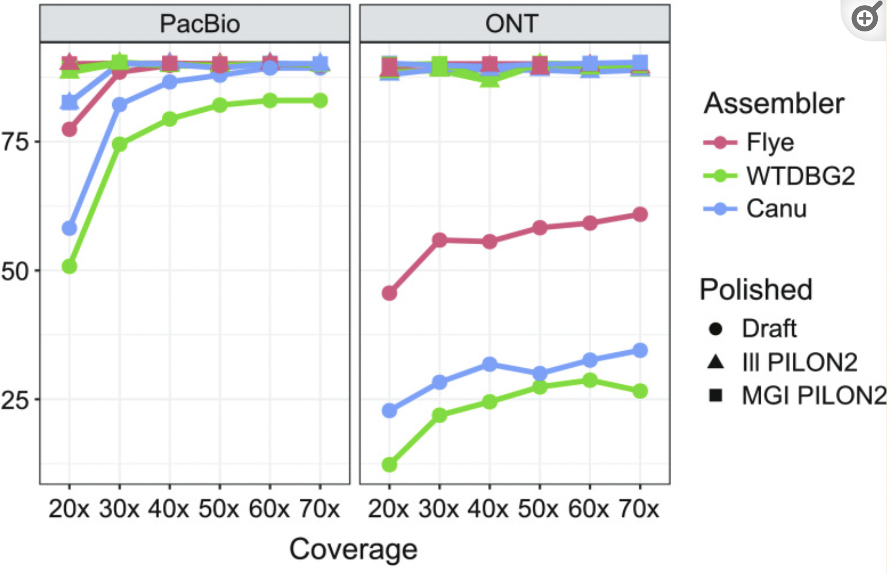
Comparing assemblers – balancing speed, accuracy, and contiguity

Slide 32
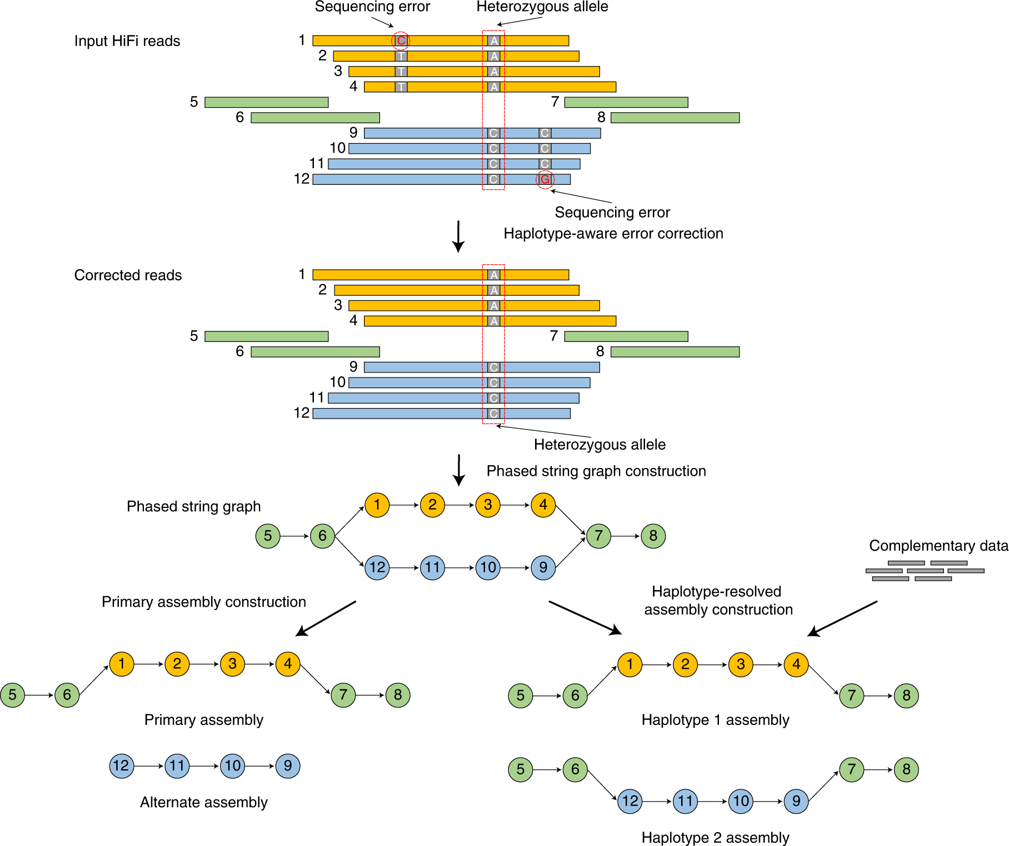
PacBio HiFi and Hifiasm

Slide 33
PacBio HiFi and Hifiasm

Slide 34
The assembly process
Assembly
Scaffolding
Raw reads
Contigs
Scaffolds
No info added
New info added

Slide 35
The assembly process
Assembly
Scaffolding
Raw reads
Contigs
Scaffolds
No info added
New info added
We need extra information to group together contigs
Ideally we want to group, orient, and space contigs into chromosomes

Slide 36
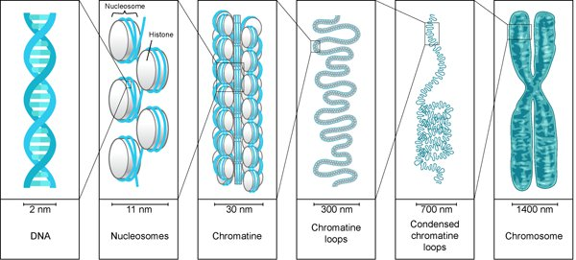
Chromatin
loops
Condensed
chromatin
loops
DNA
Nucleosomes
Chromatin
Chromosome

Slide 37
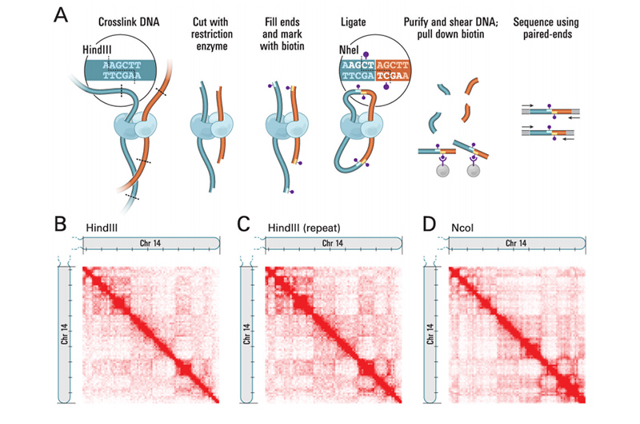
Dark red = more connections between regions

